Slide 1

Welcome to ClubRunner
District Presentation
Press <space> or left-click on mouse to advance to the next slide

Slide 2

What is ClubRunner?
ClubRunner is an administration and communication software package that will enable clubs and districts to effectively:
  Reach members
  Improve communication between members
  Better organize their club
It is an online service comprised of powerful tools designed to:
  Maintain your club data
  Boost communications
  Organize events and volunteers
  Help your club run more efficiently and easily
1-877-4MY-CLUB

Slide 3
What Does ClubRunner Do?
ClubRunner helps your district with the following tasks:
Seamlessly integrate your district database with Rotary International
Produce unlimited reports to monitor or implement different activities
Generate district directories in several formats
Track and monitor club attendance and growth
Send out targeted and personalized email communication and newsletters
Manage event registrations and reporting, with online payment
Maintain organizational charts with committee structures
Customize and maintain a dynamic website, without any technical expertise,
and much more!
1-877-4MY-CLUB

Slide 4
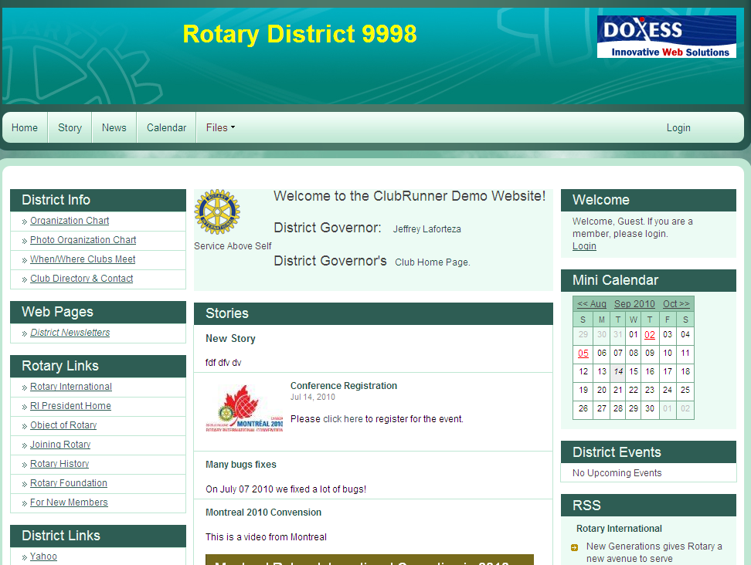
On a ClubRunner District Website, You Can…
Announce news, and more…
Edit home page stories and news
Display upcoming District events
Add site pages
…all without having to know HTML!
1-877-4MY-CLUB

Slide 5
Website Designer
Easy to update content directly on website
No HTML or FTP skills required
Photos and pictures are automatically resized and compressed
More than one member can contribute to the website – no more bottlenecks
Role-based access rights, so not all members can change all the information
1-877-4MY-CLUB

Slide 6
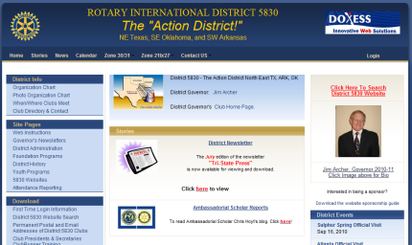
Website Designer
Flexible layouts and custom components
  Choose which components to display on your homepage and decide where to place them
  Custom components allow you to drop in simple text or large graphics, anywhere on your site
  You have the ability to decide whether a one, two or three column layout is right for you
  Now, it’s also possible to decide where you want your widgets placed
  Add website sponsor advertisements anywhere on your website
  Create a breadcrumb trail of previously viewed pages
1-877-4MY-CLUB

Slide 7

Website Designer
Customizable drop down navigation menu
  Now, your district can decide exactly what your navigation menu will look like
  Enjoy simpler site navigation with drop down menus that point to the internal, external or site pages
  Better organize and manage your site map with the user-friendly navigation tools
  Enjoy the use of unlimited submenus
  Keep specific pages private by making them password protected
1-877-4MY-CLUB

Slide 8

Website Designer
Customizable banner graphic and header
  You now have the ability to choose from available background images or upload your very own custom image
  Customize your website header to match the personality of your District
New & improved photo albums
  Upload multiple images at once
  Display images via a slideshow on your website

Slide 9
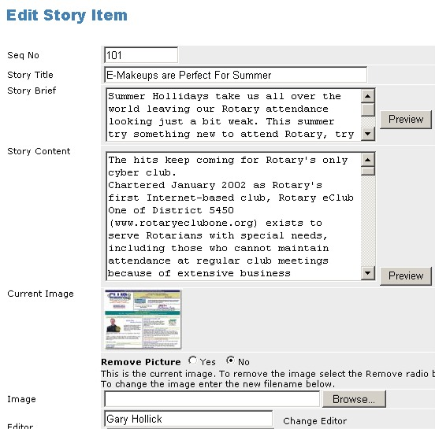

Adding a Story
To add a story to the home page, an editor logs in:
Covers Part of the Upstate New York, USA area.
Click on the image of the State map to see the Counties we cover!
1. Types in the title
2. Types in the brief caption and complete story
3. Adds their picture
4. And click Save
1-877-4MY-CLUB

Slide 10


Immediate Results
Story appears immediately on the home page
Clicking on the title or “More” will show the entire story
Clicking on the picture will show it in full size
1-877-4MY-CLUB

Slide 11
Full District Database
Maintain a secure online database accessible by district officers, club executives and members
  List executives and directors, committees and the District organization chart for current and future years
Changes made at a club level are automatically reflected at the district level
  Report club attendance and generate club statistics chart
  Track member designations and awards for each member to be displayed on their member profiles
Report data changes easily to Rotary International with the click of a button, minimizing duplicate data entry

Slide 12
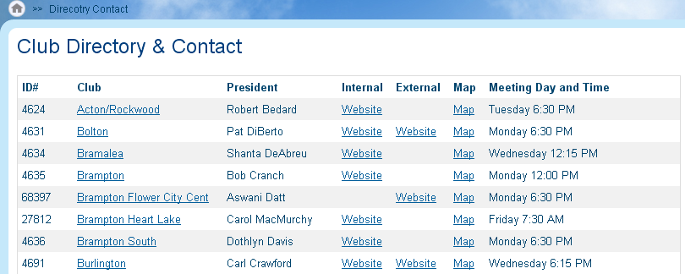
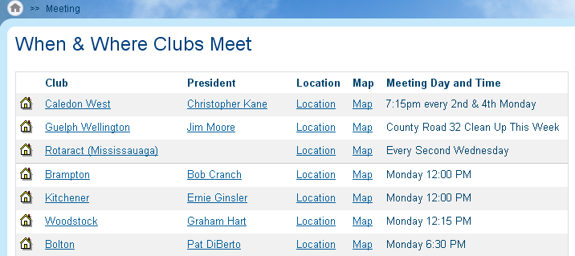
Club Directory
The Club Directory page displays all clubs, their meeting days and times, along with President names, and links to club websites
Another page, showing all clubs displayed by meeting day, and includes Presidents, location, address, and an auto-generated map.
1-877-4MY-CLUB

Slide 13
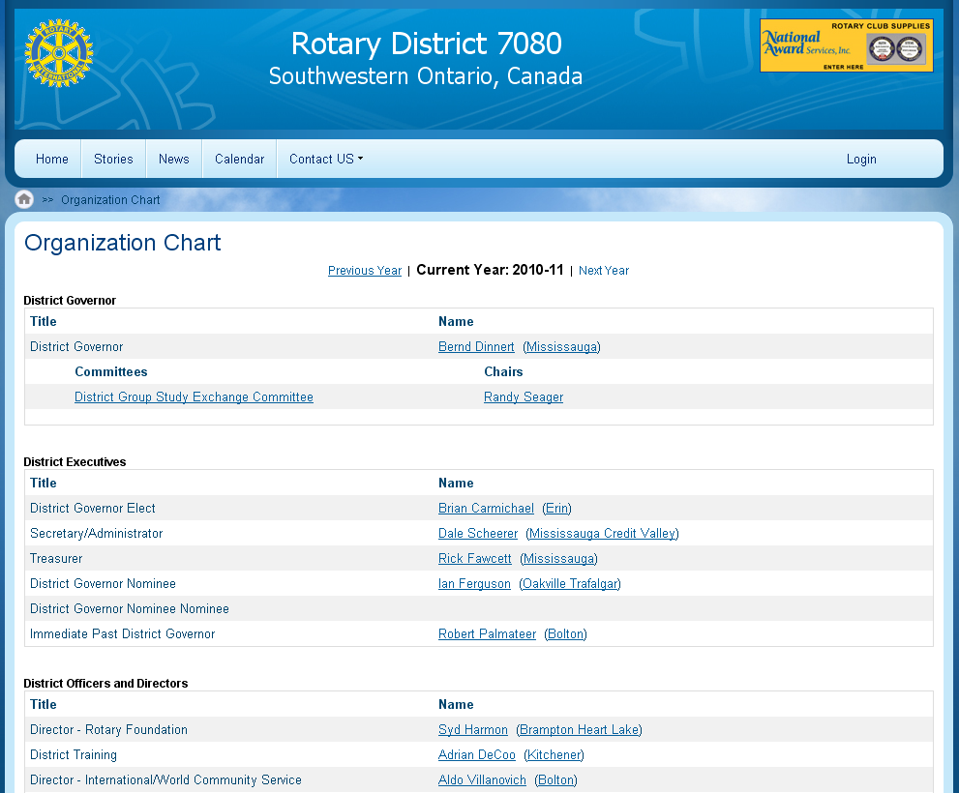
District Organization Chart
Displays all District Executives, Officers, Assistant Governors and their clubs and executives, committee directors and sub-committee chairs
1-877-4MY-CLUB

Slide 14
How Does it Work?
All changes take place online, from any computer with Internet connection
All members in the District can login
Upon login, each member is recognized as either a regular member, club executive, or district executive, plus any specific access rights granted by the Site Administrator
The Administration screen only activates the links the member has access to
1-877-4MY-CLUB

Slide 15
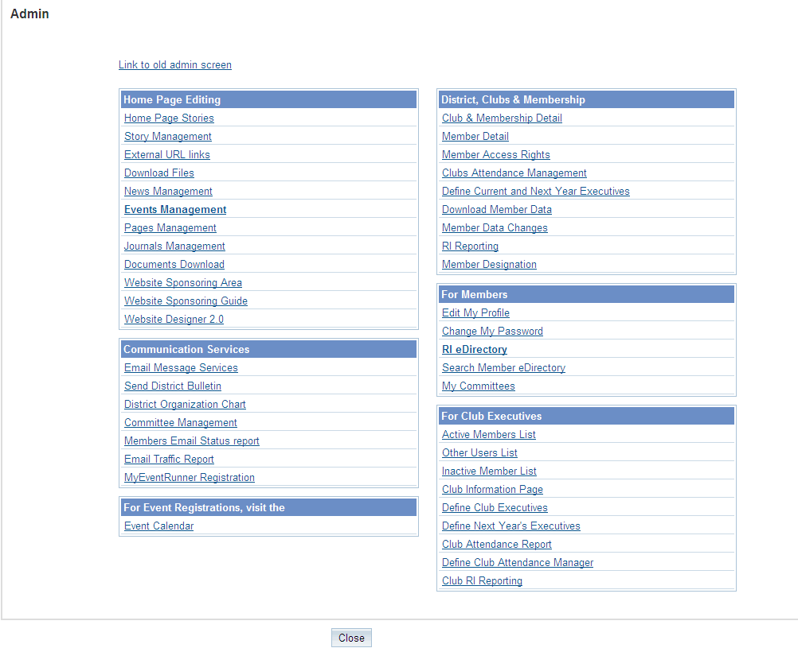
Admin Screen
Webpage Editor section
District Executive Section
Communication Tools
Club Executive Section
1-877-4MY-CLUB

Slide 16
What Can Club Executives Do?
Update their membership listing
Specify current and next year’s club executives
Create Committee listings with their corresponding Chairs and Secretaries
Update their club information such as meeting time, date, location, website address
Report monthly attendance
Register members for district events
View online district directory
1-877-4MY-CLUB

Slide 17
What can District Executives Do?
Everything a club executive can do, for any club, plus:
Generate monthly district attendance reports
Remind clubs that have not submitted attendance
Register any member for district events, plus view registered attendees and email
Broadcast emails to all Presidents, all Secretaries, all Officers, etc.
Send out a bulletin to all members
1-877-4MY-CLUB

Slide 18
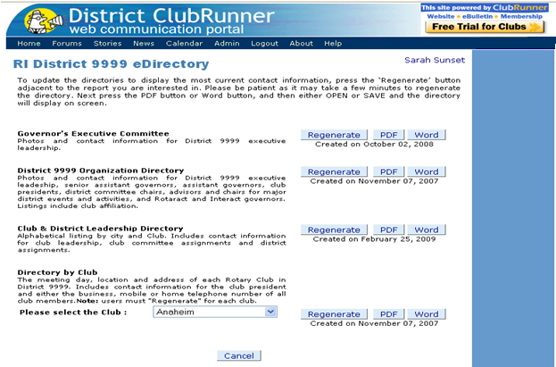
District Directories & Reports
All members can download a Word or PDF version of the District Directory, which is generated from all the data on the website
Choose from a variety of district directories, including:
  Fill District Directory
  District Staff & Clubs
  Next Year’s Club Executives
1-877-4MY-CLUB

Slide 19
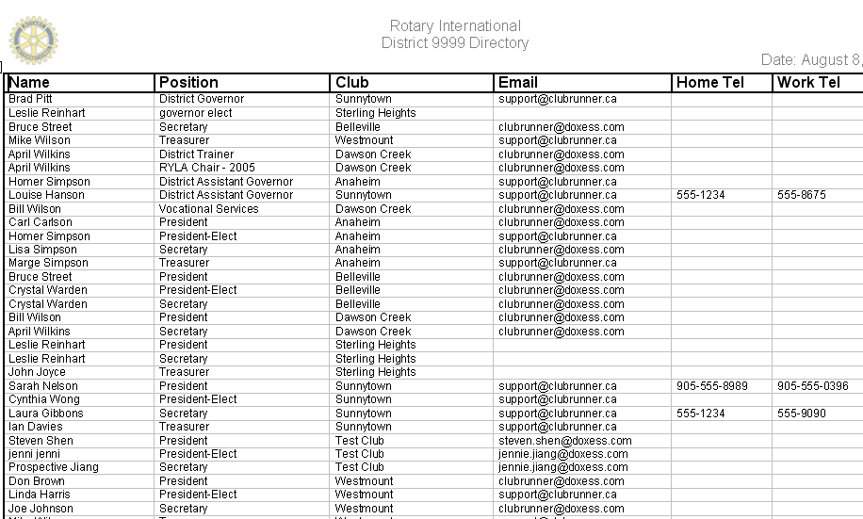
District Directories & Reports
A sample of one of the available directories.
Members can print this at home, or save on their computer for future use.
A text version of the download is also available for import into Handhelds or contact software.
1-877-4MY-CLUB

Slide 20
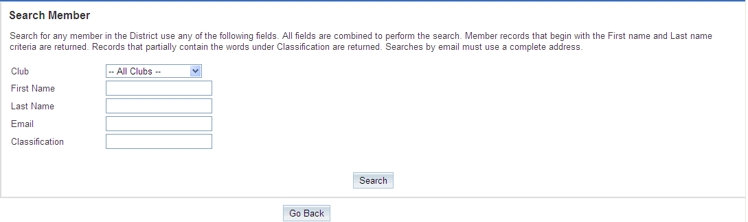
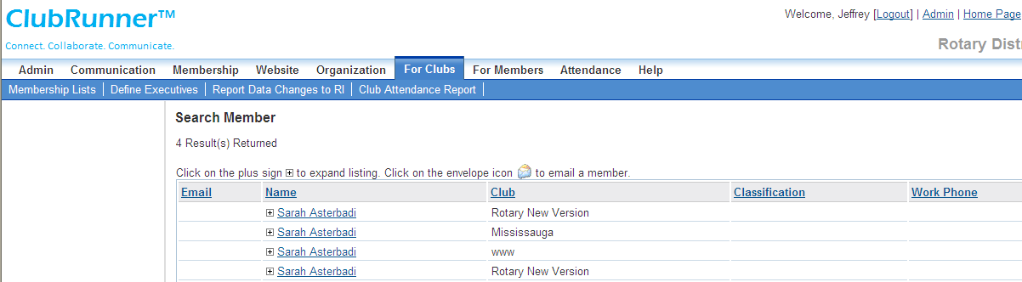
District Directories & Reports
To easily find members of a club, you can search the district database by first or last name, email address or classification.
Once results are returned, they will appear in a list format.
1-877-4MY-CLUB

Slide 21
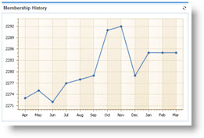
District Directories & Reports
Visualize your district’s statistics and metrics with charts and graphs
Now district officers and executives can easily keep track of:
  The clubs in your district with the highest growth
  The gender distribution within the district
  Overall membership and numbers for the entire district
  Clubs with the best and worst attendance
  Membership history

Slide 22
Unique Benefits
All information updated by Club Executives, regular members, and District executives is kept in one central location
Club Directory, Where Clubs Meet, and the Organization Chart automatically reflect any changes
Multiple website editors make site more alive and kept up-to-date. Removing the need for technical skill allows for more people to get involved
Integration with Rotary International’s database to easily report member changes without duplications or errors.
1-877-4MY-CLUB

Slide 23
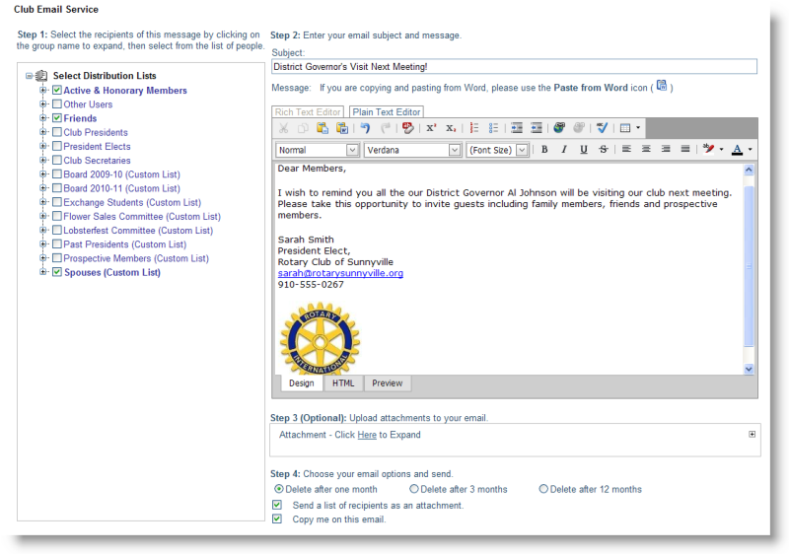
E-mail Message Center & Groups
Streamline communication across a group
When executives change, the system will automatically redirect communication to the new person
Two-level circulation allows you to integrate the flow of information among clubs, districts, and zones
ClubRunner maintains a centralized, up-to-date list of all groups and e-mail addresses
  All members are categorized once, making targeted mailing easier
Message Center is great for managing committee meetings, sending invitations or agendas for meetings, and circulating the latest news
1-877-4MY-CLUB

Slide 24
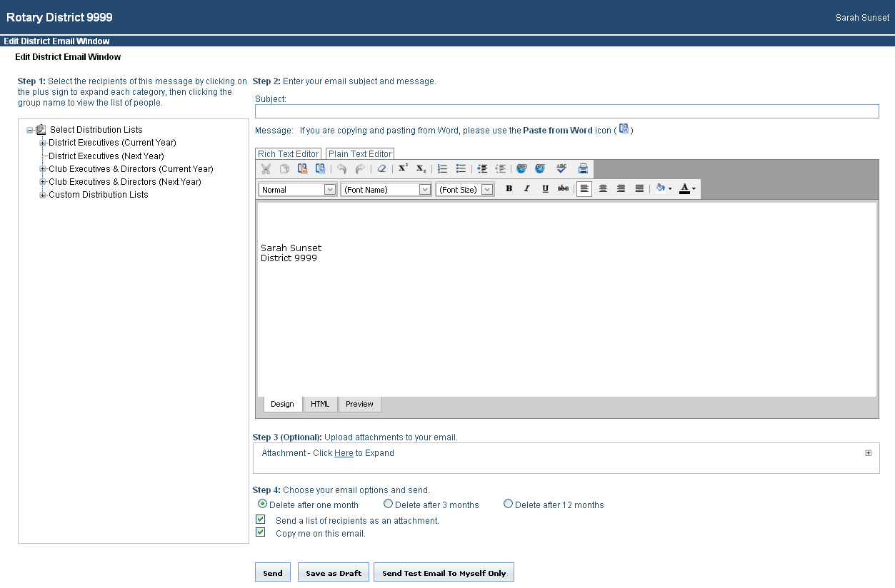
E-mail Message Center & Groups
Sending out a broadcast email on ClubRunner is easy, without ever having to keep track of a single email in your address book.
Compose message
Select Your Recipients
Choose the mode to preview your message
Choose your email send and archive options
Add attachments
1-877-4MY-CLUB

Slide 25
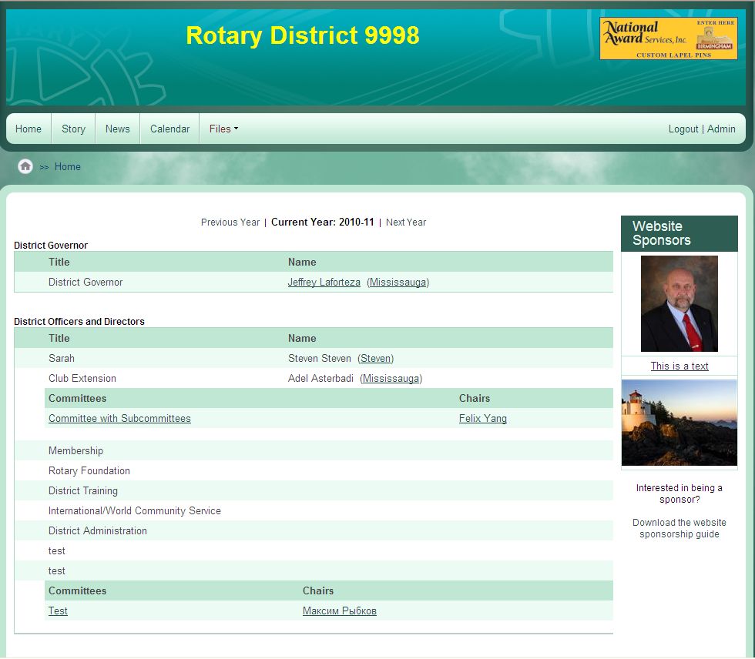
Public Message System
Anytime an executive name appears on the website, it is a link.
This does not reveal the email address. Instead, it allows visitors to contact this person through the Public Message System.
1-877-4MY-CLUB

Slide 26
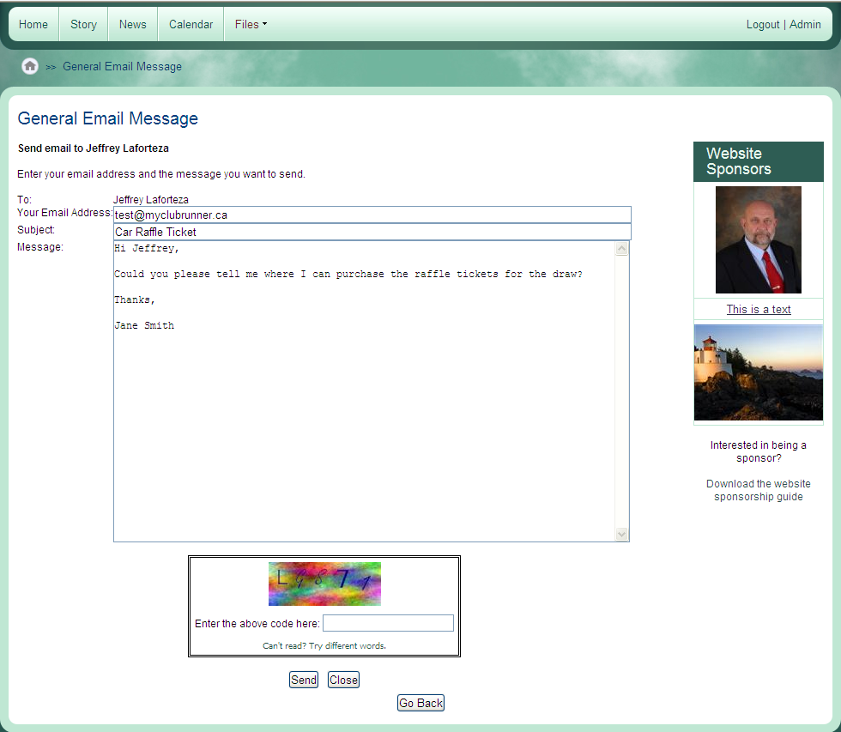
Public Message System
Clicking on the name, visitors get the opportunity to type in a message.
Member’s email address is concealed
When visitor clicks on ‘send’, the member will receive the message in their Inbox, and be able to reply to it, all without revealing email addresses on the web.
1-877-4MY-CLUB

Slide 27
Public Message System
Keep a listing on the website, automatically hiding past events
Send an email invitation to all members or just presidents with one click
A limit of emails that can be sent to executives is imposed to prevent spam messages
1-877-4MY-CLUB

Slide 28
Unique Benefits
Each email message is personalized with the member’s name and club
You can optionally attach the recipient list, thus reducing unnecessary forwards
Always uses the latest emails and members on database, so if a member changes his/her address, it is reflected everywhere, in all distribution lists, without need to notify others.
Choose to archive your emails after 1, 3 or 12 months
Email addresses of members remain hidden and protected from spam
Presidents can forward message to all their members with one click
1-877-4MY-CLUB

Slide 29
Event Planner
Promote your event
  E-mail the event announcement to all members and friends with the click of a button
  It will also appear on your home page, complete with a map generated automatically using the address.
  Event announcements are emailed to club members and other members in the District.
  Generate a signup sheet and email it to the presidents of other clubs in your District
1-877-4MY-CLUB

Slide 30
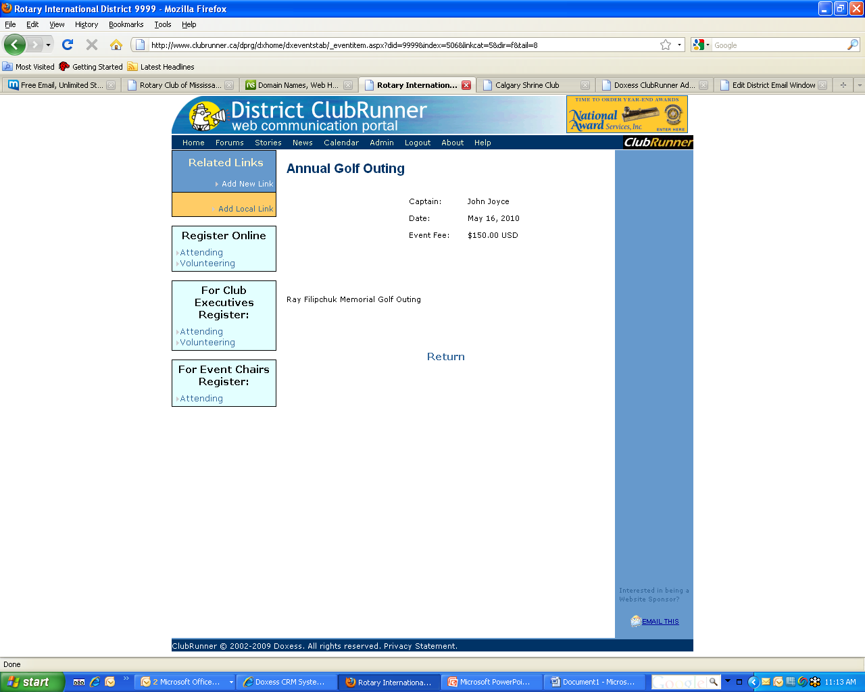
Event Planner
All events can be posted to the website on their own page
Related Links can be added, such as PDF forms and links to other websites
Register Online link available to District members
1-877-4MY-CLUB

Slide 31
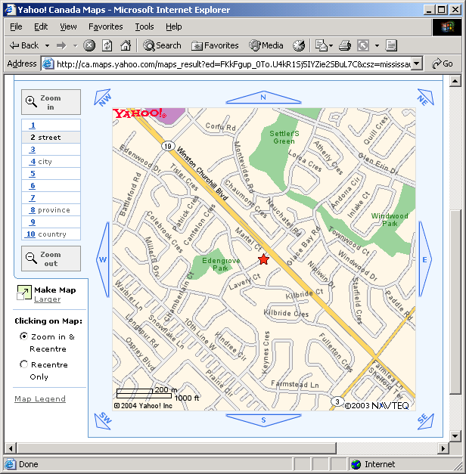
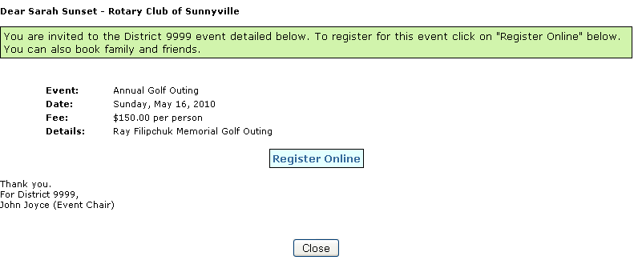
Email Invitations
Maps auto-generated based on address you provide
Email Invitations out to members asking them to register online
1-877-4MY-CLUB

Slide 32
Event Planner
Register attendees online
  Recipients can register online for the event
  Register members of other clubs, friends and guests
  Generate a current listing and count of all attendees at any time
  Keep track of account balances
1-877-4MY-CLUB

Slide 33
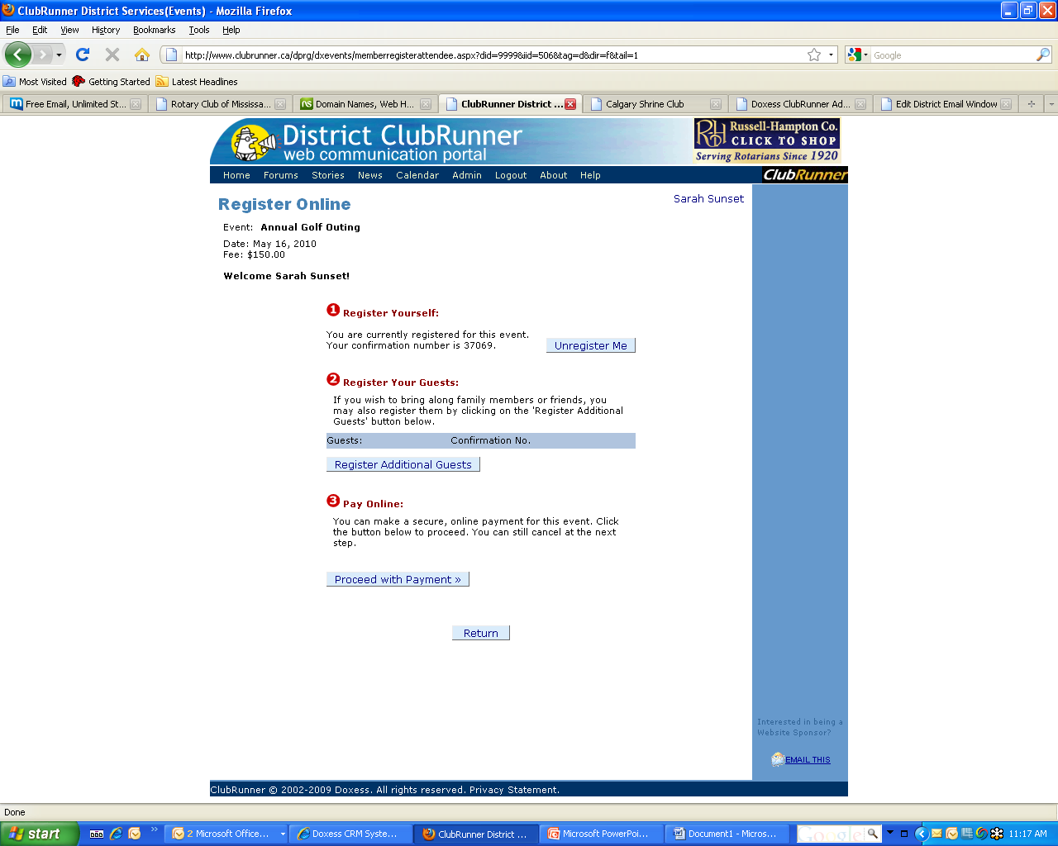
Register Online
Once a member clicks on “Attending”, they can register themselves and any guest they wish to bring along
Online payment can be collected for the event securely by credit card
1-877-4MY-CLUB

Slide 34
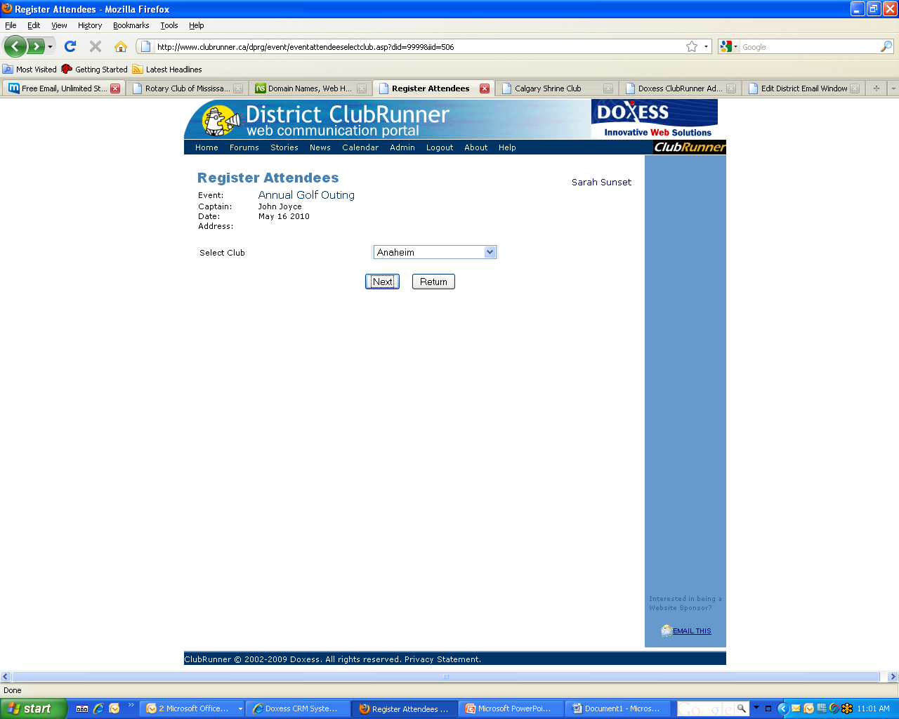
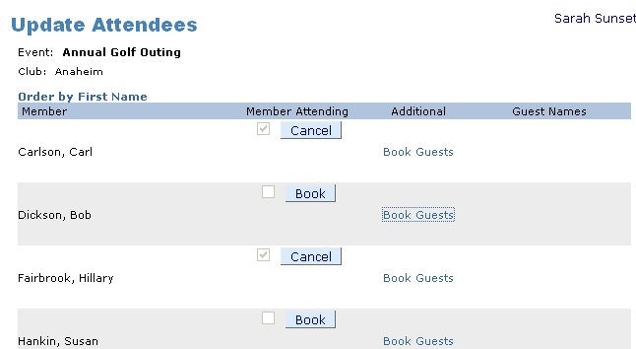
Register Online
Executive members can also register multiple people with a few quick clicks.
STEP 1: Select the club
STEP 2: Select all members and click “Book”
1-877-4MY-CLUB

Slide 35
Event Planner
Manage fundraising activities
  Assign volunteer tasks and allow members to book themselves for any available tasks online
  Volunteer signup sheet will be posted automatically on the eBulletin reminding the volunteers of their commitments
Communicate with your attendees and volunteers
  Send out a message to all your attendees or volunteers without having to juggle with e-mail addresses.
1-877-4MY-CLUB

Slide 36
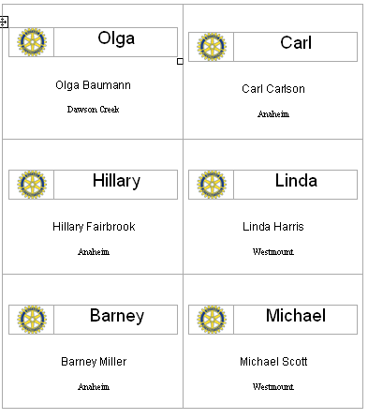
Event Planner
Get help from other clubs in your area
  Send out a ‘help needed’ message to other clubs in your area requesting volunteers
Print name tags
  Print name tags for every attendee
  Name tags are generated automatically on a Word document visible in the browser and ready to print
Need to do more? MyEventRunner™ is a do-it-yourself customizable registration form designer, available to create, manage and promote your event registrations and collect payment. Click here for more information.
1-877-4MY-CLUB

Slide 37
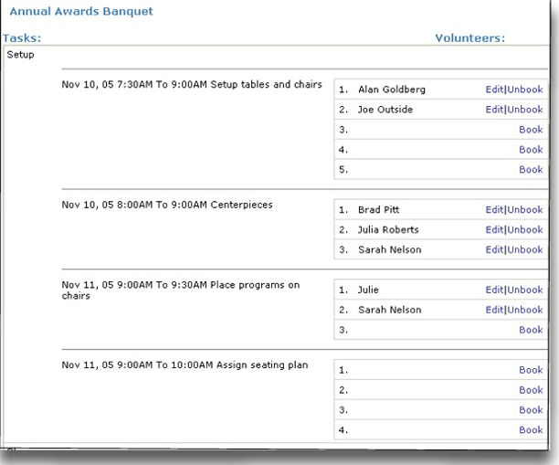
Volunteers & Tasks
Members can book themselves or non-members as volunteers for tasks.
1-877-4MY-CLUB

Slide 38
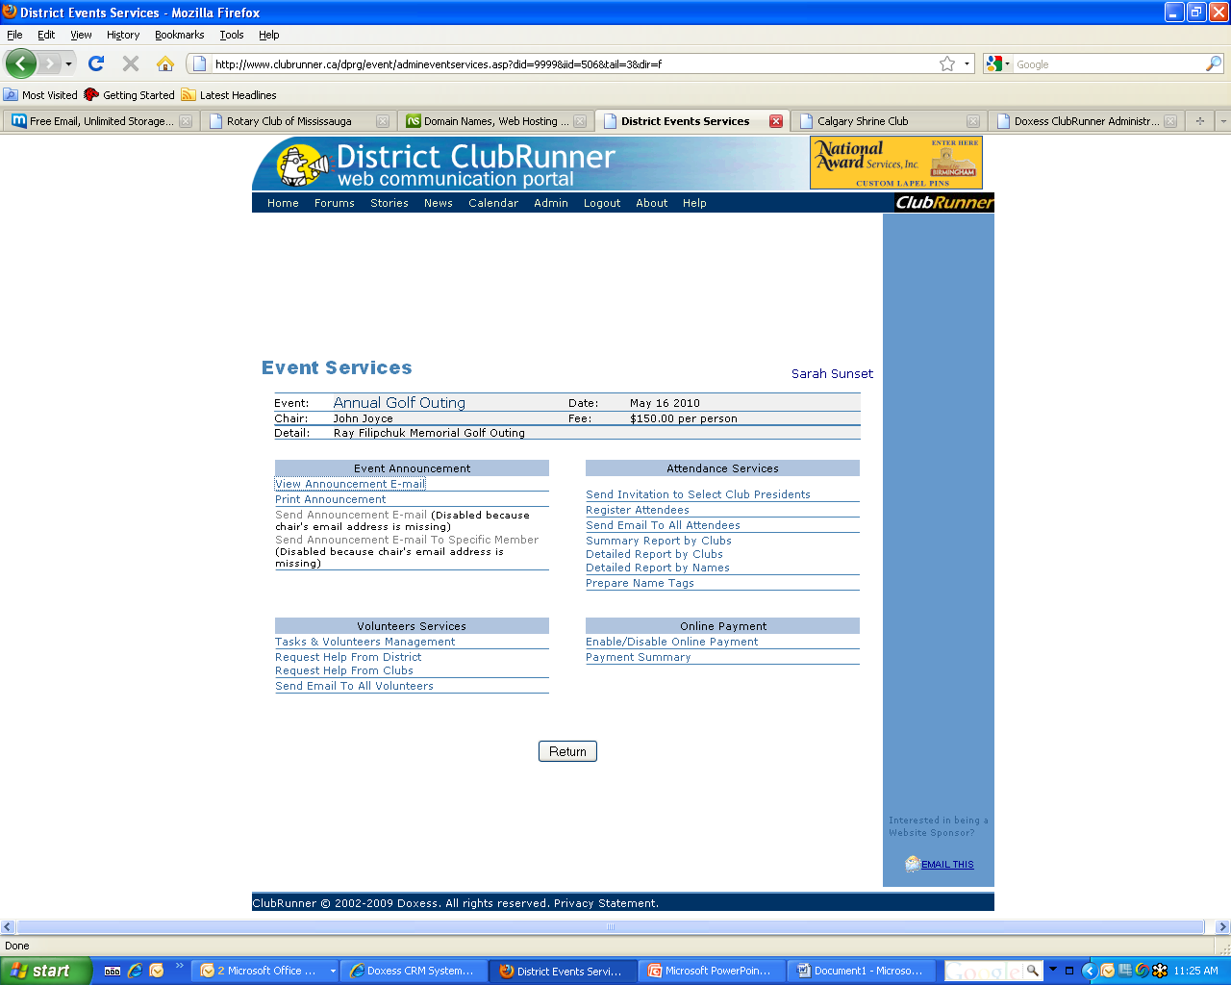
Event Planner
Event Services Page contains many useful tools to manage your event
Sending out email invitations
Viewing and Contacting Attendees
Printing Nametags
Managing volunteer tasks and sign ups
1-877-4MY-CLUB

Slide 39
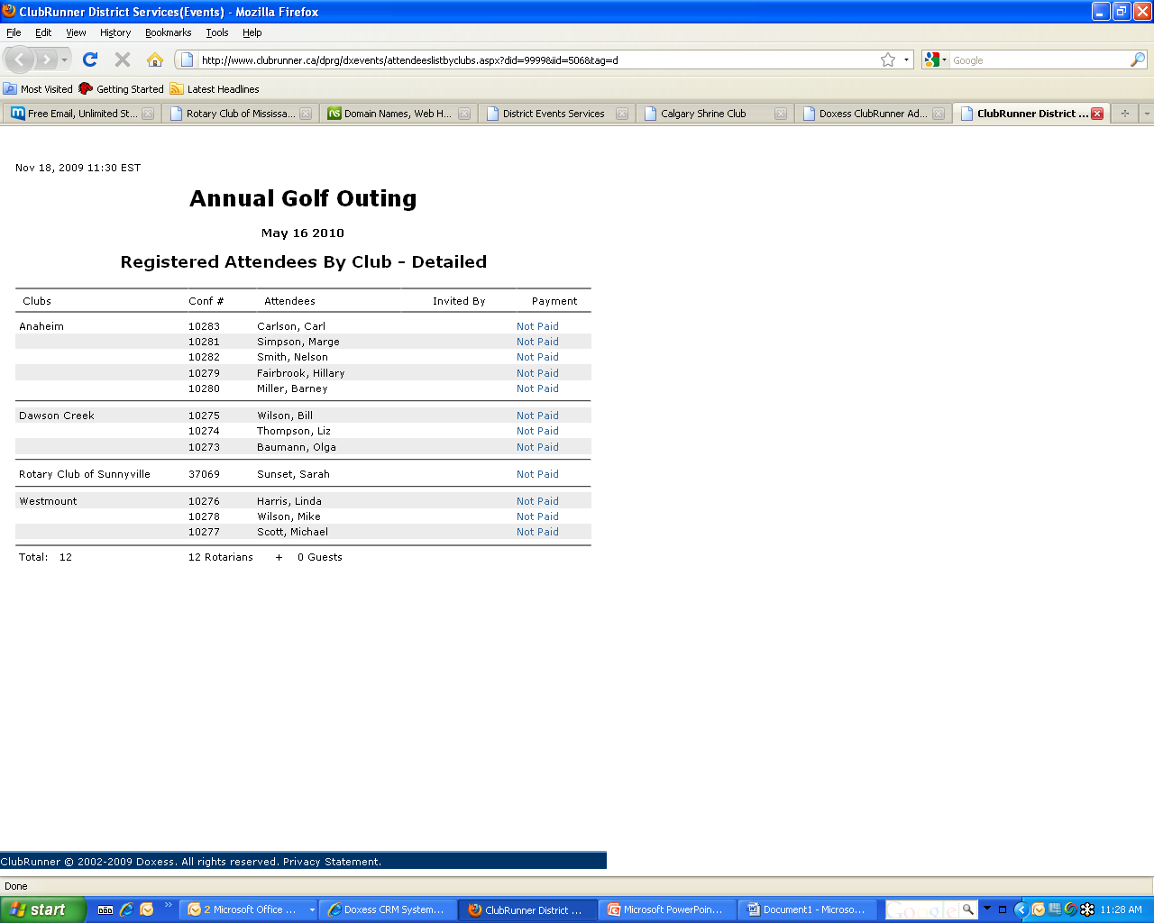
Registration Reports
Event registration reports are available, such as this event attendees list.
1-877-4MY-CLUB

Slide 40
Online Payment & eCommerce
Already integrated with the Dues & Billing Module and MyEventRunner ™ for event registrations
Choose where and when online payments are made or use the Virtual Terminal to process transactions manually
All funds are deposited directly into your bank account
ClubRunner will automatically update reports to reflect the payments

Slide 41
Online Payments & eCommerce
Credit Card Processing
  ClubRunner is proud to partner with industry leaders in payment processing to offer you with simple, reliable, secure and cost effective electronic payment and authentication services
Virtual Terminals
  All merchant accounts come with Virtual Terminals to allow you to manually enter in credit card payments online
    Allows members to pay through telephone or in person
Security
  ClubRunner complies with PCI standards to ensure all transactional data is secure
  All forms that handle credit card information and related confidential information are SSL encrypted and certified
  ClubRunner does not store any Credit Card information

Slide 42
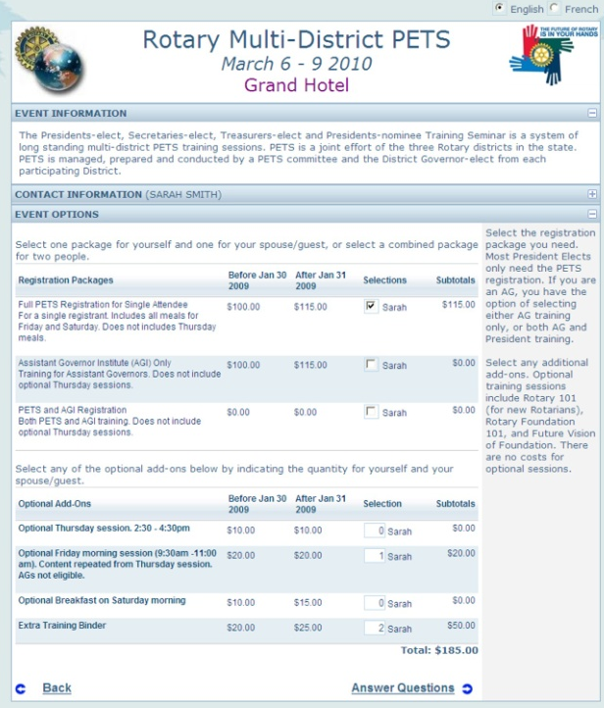
What is MyEventRunner?
Available as a ‘standalone’ MyEventRunner is a powerful do-it-yourself customizable and flexible event registration system designed for Districts. There are 2 versions available: Lite (included) & Pro.
Your Online Payment & eCommerce Module includes the Lite Version
What you get with the Pro Version:
Unlimited Questionnaires
Payment Installments and tracking
Payment by Check Option
Credit Card Processing with Integrated Merchant Accounts
Early Bird Pricing, and much more!
1-877-4MY-CLUB

Slide 43
How will MyEventRunner benefit us?
  Access your event registration form anywhere you have an Internet connection
  Set your registration form up in minutes! Build it yourself using our easy to use tools, and accept registrations the next day.
  Collect your fees instantly with registrations, ensuring financial success for your event.
  Gather more information from your registrants through our questionnaire section, to help you plan your event
  Run reports up to the minute to monitor the success of your event.
1-877-4MY-CLUB

Slide 44
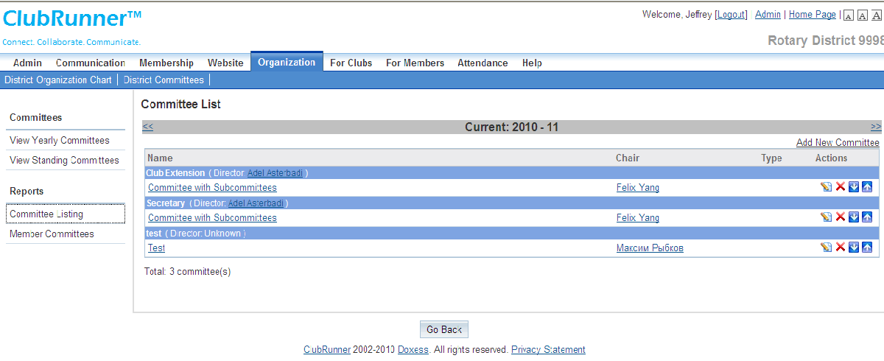
Committees Management
Create, manage and store all committees lists along with designated Chairpersons, Secretaries and members.
1-877-4MY-CLUB

Slide 45
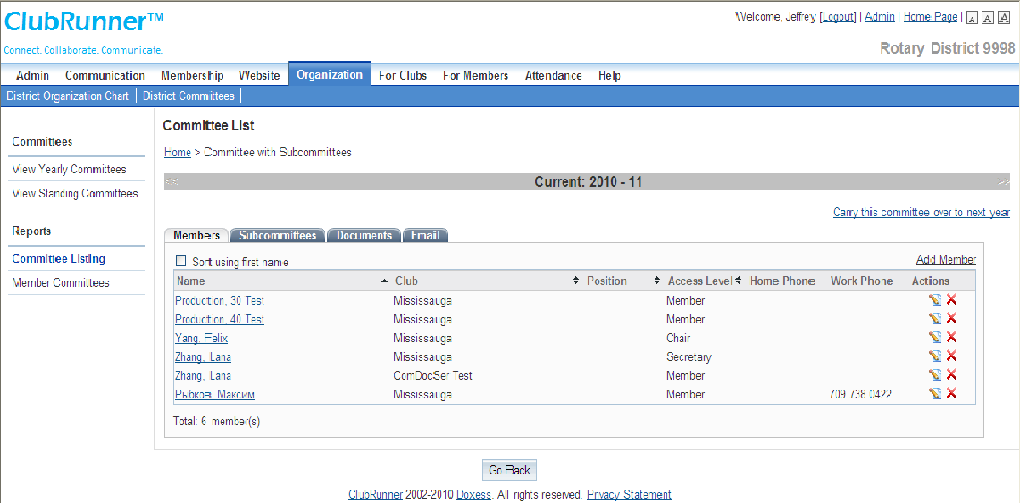
Committees Management
You have the option of duplicating this committee record for the next Rotary Year
Create subcommittees
Send emails to committee members
Post documents
1-877-4MY-CLUB

Slide 46

Benefits
District Image
Professional online presence
Efficient reporting tools
Easier to keep website current
Highlight events
Showcase clubs
Rotary information for prospective members
Committee and program pages
1-877-4MY-CLUB

Slide 47

Benefits
Efficiency & Cost Effectiveness
Using email reduces costs of administration, postage and telephone
Centralizing information keeps everyone on the same page
Allowing clubs to update their information directly reduces maintenance required for website
Online District Directory eliminates need for printed directory
1-877-4MY-CLUB

Slide 48

Data Security & Availability
Firewall & anti-virus protection
Private information (e.g. member list, emails) not accessible by public
Backups of website and membership data automatically made every 4 hours
Turnkey service – eliminates need for hardware, software, or large disk space
No software installation required
Works on PCs & Macs
1-877-4MY-CLUB

Slide 49

Privacy
No personal information or email address ever exposed on public website
Member’s access to information is restricted based on his or her role in the District or Club
Strict Privacy Policy assures you that ClubRunner will not release data to third party in any form
Read our Privacy Policy
1-877-4MY-CLUB

Slide 50


Awards
ClubRunner was awarded the Microsoft Impact Award for Community Leadership after its release in April 2003.
This award is presented by Microsoft to one software application across the country, that makes a lasting impact on the community and is beneficial to its recipients.
1-877-4MY-CLUB

Slide 51
“Our ClubRunner District Website has dramatically increased our
ability to directly reach the vast majority of our members.
Now that a large number of our Rotary Clubs are also choosing
ClubRunner websites, our web-based communication system
throughout the district is becoming even more valuable.”
Testimonials
“ClubRunner is so easy for someone
with little computer experience or
HTML knowledge, to create an
interesting and informative site
quickly.”
"ClubRunner has literally revolutionized communications in District 7080. For the first time ever we are able to selectively target our communications. We are no longer forced to funnel everything through the club presidents.
As a result we have been able to decrease the information overload generally experienced by presidents and increase our information flow to every level of Rotary membership in the District.
ClubRunner has enabled Rotarians in District 7080 to be more efficient and more effective. We are able to spend less time as administrators and more time doing community service. ClubRunner delivers a service that allows us to operate as volunteers but deliver as professionals."
“It has forced our club to consider a whole new approach
to communications, both internal
and external…”
"As a former district webmaster I can't begin to extol the advantages of our new District ClubRunner site.
Seems like every time I login, I discover yet another feature I wasn't aware of.
Superb communication tool - highly recommend to all Rotary clubs."
“ClubRunner is one of the easiest turnkey websites I have ever used.”
1-877-4MY-CLUB

Slide 52


Contact Us
For more information, or to set up ClubRunner for your district, please call 1-877-4MY-CLUB, or email us at salesinquiry@clubrunner.ca
Visit us at www.MyClubRunner.com to find out more!
© 2010 Doxess. All Rights Reserved. This presentation is for informational purposes only. Doxess makes no warranties, express or implied, in this summary. ClubRunner is a registered trademark of Doxess.
1-877-4MY-CLUB

